Slide 1
Tutorial 4
T03/08
Goh Rui Zhi
gohruizhi@u.nus.edu

Slide 2
Announcements
Reminder: Assignment 1 is due 20 Sept 2021, 2359 HRS
Mid-Term Exam:
Date: 1st October, 10am (Week 7)
Scope: TBC
Mode: Examplify (Please make sure it is set-up properly!)

Slide 3
Question 1
There are at most 100,000 hair glands on a human’s scalp, and different persons have different numbers of hair glands. Suppose there are 1,000 undergraduate students in SoC. Are the chances high that there exist two SoC students with the same number of hair glands?
(Assume the number of hair glands, that a person has, follows a uniform distribution)

Slide 4

Birthday Paradox
Want to find:
Probability that 2 students share the same # of hair glands
= $1 −{P(All Different number of hairglands)}^{}$
= $1 −{P(Different number of hairglands)}^{Number of Pairs}$

Slide 5
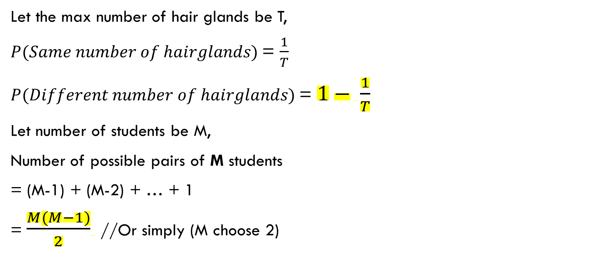
Birthday Paradox
Let the max number of hair glands be T,
$P(Same number of hairglands)$= $\frac{1}{T}$
$P(Different number of hairglands)$= $1− \frac{1}{T}$
Let number of students be M,
Number of possible pairs of M students
= (M-1) + (M-2) + … + 1
= $\frac{M(M−1)}{2}$ //Or simply (M choose 2)

Slide 6

Birthday Paradox
Probability that 2 students share the same # of hair glands
= $1 −{P(Different number of hairglands)}^{\frac{M(M−1)}{2}}$
= ${1 − (1−\frac{1}{T})}^{\frac{M(M−1)}{2}}$ // Exact Value
≈ $1 −e^{−\frac{M^{2}}{2T}}$

Slide 7

Question 1
M = 1000, T = 100,000
Probability that 2 students share the same # of hair glands
= ${1 − (1−\frac{1}{100000})}^{\frac{1000(1000−1)}{2}}$
= 0.9932…

Slide 8
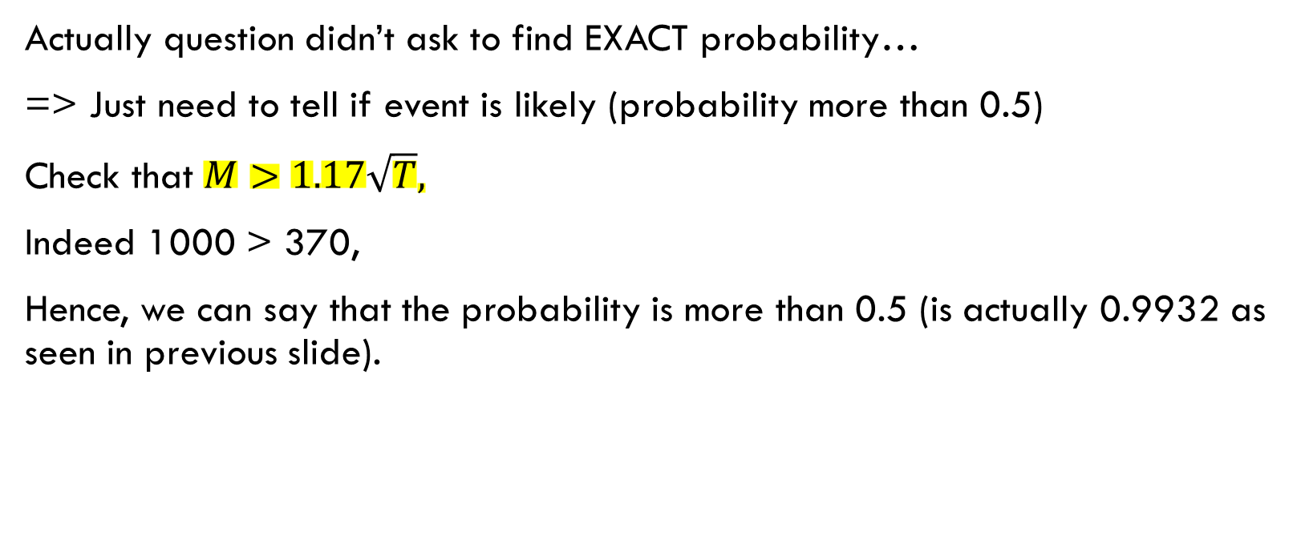
Question 1
Actually question didn’t ask to find EXACT probability…
=> Just need to tell if event is likely (probability more than 0.5)
Check that $M>1.17\sqrt{T},$
Indeed 1000 > 370,
Hence, we can say that the probability is more than 0.5 (is actually 0.9932 as seen in previous slide).

Slide 9

Question 1 discussion
Questions in exams will not ask to find EXACT probability…
Just apply this formula!
Having trouble remembering which is M and T?
The bigger number usually goes to T
The smaller number usually goes to M
Why?
$$M>1.17\sqrt{T}$$
What happens when we have more students (M) than number of hair glands (T)?
Pigeon Hole principle!!

Slide 10
Question 2
Suppose a stream cipher always uses a randomly and uniformly chosen 64-bit IV when encrypting a plaintext into a ciphertext. In a set of collected 2³³ ciphertexts, determine whether the probability that there exist two ciphertexts with the same IV is greater than 0.5.

Slide 11

Question 2
Just apply formula!
What is M, and what is T?
M = # of ciphertext = 2³³
T = # of IVs = 2⁶⁴
Inequality holds
$$M>1.17\sqrt{T}$$

Slide 12
Question 3
Cryptographic hash functions, such as SHA-1, are often employed to generate “pseudo-random” numbers. Given a short binary string s, which is also known as the seed, we can generate a pseudorandom sequence x₁, x₂, x₃, . . ., where each x_{i} is a 160-bit (20-byte) string, as follows:
Let x₁ = SHA-1(s), and let x_{i+1} = SHA-1(x_{i}) for i ≥ 1.
Bob implemented a security protocol, which required a random 128-bit string k to serve as the AES encryption key, and a random 128-bit string v to serve as the IV. Bob first set the seed s to be a string of 160 zeros, and then obtained x₁ and x₂ as described above. Bob subsequently took the leading 128 bits of x₁ as the v; and the leading 128 bits of x₂ as k.

Slide 13
Question 3
Bob claimed the following:
“Since SHA-1 produces a random sequence, the 128-bit key and the 128-bit IV are therefore random, thus meeting the specified security requirement.”
Assume, as usual, that an eavesdropper could obtain the ciphertexts, and that the mechanism used by Bob to generate the key is publicly known. Give a ciphertext-only attack that finds the key k, and explain why Bob’s argument is wrong.

Slide 14
Question 3
0000000…0000000
SHA-1
SHA-1
_{K (}x₂₎
// 160 bits of 0s
_{IV}
We want to find k:
k = first 128 bits of x₂
Remember SHA-1 is deterministic!
Just run 160 bits of zeros through SHA-1 twice and get the first 128 bits of x₂

Slide 15
Question 4
Consider the same scenario given in Question 3. Bob realized his mistake, and he changed his protocol. The updated program chose the seed s by using the following code snippet:
#include <time.h>
#include <stdlib.h>
srand(time(NULL));
int s = rand();

Slide 16
Question 4
After the seed s was set, Bob followed the same steps described in Question 3 to generate x₁, x₂, and then derive the 128-bit iv and 128-bit k.
(If you are not familiar with C, the above C code can be replaced with a similar Java code that utilizes java.util.Random as mentioned in Lecture 1.)
Explain why the above mechanism is still not secure by giving an attack that can obtain the AES key. As usual, we assume Kerckhoffs’s principle (i.e. a strong adversary knows the algorithm and all other information except the secret key.) In your solution, clearly state the information that the adversary has access to.

Slide 17
Question 4
What does srand() do?
“The srand() function sets its argument as the seed for a new sequence of pseudo-random integers to be returned by rand(). These sequences are repeatable by calling srand() with the same seed value.”
Still deterministic!
What does time(NULL) do?
time(NULL) returns the current calendar time (seconds since Jan 1, 1970)
Returns Long data type (64bits)

Slide 18
Question 4
Few ways an attacker can get the key, k:
1. Guess (smartly) the time when the Bob gets the seed
Notice that we can narrow down our search if we can estimate when Bob generates the seed
1 year = 31million seconds (approx), 1 month = 2.6 million seconds (approx)
Worse case: 2^64 guesses
2. Guess s instead
Int data type = 32bits
Not hard to brute force a 32bit number

Slide 19
Question 5
What is the difference of using Java.security.SecureRandom or /dev/urandom compared to the random number generator used in Question 4?
Java.security.SecureRandom:
This class provides a cryptographically strong random number generator (RNG). A cryptographically strong random number minimally complies with the statistical random number generator tests specified in FIPS 140-2, Security Requirements for Cryptographic Modules, section 4.9.1. Additionally, SecureRandom must produce non-deterministic output. Therefore any seed material passed to a SecureRandom object must be unpredictable, and all SecureRandom output sequences must be cryptographically strong.

Slide 20
Question 5
Bob again realized his mistake. In his most updated version, the seed s is generated using a more secure random number generator shown on Slide 73 of Lecture 1 Part 3. The hash function SHA-1 is then similarly applied on s to obtain k and v.
Does Bob use a correct mechanism to generate a good seed now? Still, can you do a ciphertext-only attack that finds k? Suggest an algorithm to find the key k used.

Slide 21
Question 5
Does Bob use a correct mechanism to generate a good seed now?
Yes!
Can you do a ciphertext-only attack that finds k?
Still Yes! The way the key is generated is still insecure!

Slide 22
Question 5
Attacker knows the IV!
=> Just need to guess the remaining 32bits, to get the 160bit x₁
=> We get k by sending [(128-bits IV) || (32 bits guess) ] through SHA-1
Random Seed
SHA-1
SHA-1
_{K (first 128bits)}
_{IV (first 128bits)}

Slide 23
Question 6
Bob believes that he has discovered a simple yet secure public key scheme, which he named BC1 (Bob Cipher 1). It employs only a hash function like SHA-256, and a secret-key encryption scheme like AES. (Note that SHA-256 is a hash function in the family of SHA2, which produces 256-bit digest.)
The scheme works as follows:
The private key of BC1 is a randomly chosen 320-bit string k, and its public key is a 256-bit w = SHA-256(k)
Encryption: given the public key w and a plaintext x, employ AES to encrypt x with w as the 256-bit encryption key.
Decryption: given a ciphertext c and the secret key k, compute w = SHA-256(k), and then decrypt c using w.

Slide 24
Question 6
Bob made this statement: “Note that SHA-256 is believed to be one-way, and hence it is difficult to derive the private key k from the public key w = SHA-256(k). Therefore, the public-key scheme is secure.”
Explain to Bob why BC1 is terribly insecure, and why his statement above is logically wrong
(Hint: Refer to the security requirement of a public-key scheme mentioned on Slide 10 of Lecture 3.)

Slide 25
Recap: Security Req of PK scheme
1: It must be difficult to get the private key from the public key.
2: Given the public key and the ciphertext, but not the private key, it is difficult to determine the plaintext
Without a knowledge of the private key, the ciphertext resembles a sequence of random values

Slide 26
Question 6
Answer:
Bob is wrong since an adversary can simply use his public key w to decrypt
the ciphertext c and obtain the plaintext x.
=> Second requirement not satisfied!

Slide 27
Question 7
Let us consider again the penguin example shown in “Issue 2: ECB with RSA” of Lecture 3.
Let b₁, b₂, b₃, . . . be the blocks of the plaintext. Suppose that Bob is now concerned with both confidentiality and integrity. Hence, he chooses two secret keys k₁ and k₂. The penguin image is encrypted using AES under the CBC mode-of-operation using k₁ as the secret key.
For integrity, for each block b_{i}, a MAC t_{i} is computed using HMAC with k₂ as the key. That is, the MAC t_{i} = HMAC(b_{i}, k₂).
Now, the final ciphertext consists of the outputs of AES and all the MAC values.
Can the proposed scheme’s “confidentiality” and “integrity” be compromised?

Slide 28
Question 7
Confidentiality:
Note that no IV is being used
Two identical blocks will be encrypted into different blocks (Thanks to CBC)
But two identical plaintext will still be encrypted into same ciphertext
Very vulnerable to known plaintext attack (why?)
In known ciphertext scenario, attacker can still know that the ciphertext comes from the same plaintext
Information leakage through HMAC digest
Same plaintext block = same digest

Slide 29
Question 7
Block a
Block b
Swap
Integrity:
Attacker can reorder the ciphertext blocks.
During decryption, plaintext is altered
HMAC cannot detect this (Only applies to individual blocks)
Integrity of individual blocks are preserved but not for the entire plaintext
Solution: Give each blocks a sequence number. Hence, able to detect re-ordering attacks.

Slide 30
Question 8
Lecture 3 states two security requirements of a cryptographic hash function h(), namely collision resistant and preimage resistant (one way).
The former says that it is difficult to find m₁, m₂ such that h(m₁) = h(m₂) and m₁ ≠ m₂.
The latter says that, given x, it is computationally difficult to find a m such that h(m) = x.
Show that if a hash function h is collision resistant, then it is also one-way (i.e. collision-resistant(h) ⇒ one-way(h)).

Slide 31
Question 8
Hint: You can prove the implication statement above by showing that its contrapositive is true. That is, ¬ one-way(h) ⇒ ¬ collision-resistant(h). This contrapositive basically says that if it is easy to invert h(), then it is also easy to find a collision. This can be established as follows:
Suppose there exists a fast algorithm A that, when given x, successfully finds a m such that
h(m) = x
Given A, then there also exists another fast algorithm Ã that can successfully find a collision with high probability. (i.e. Ã can find m₁, m₂ such that h(m₁) = h(m₂) and m₁ ≠ m₂)
Now, suggest how we can construct Ã from A

Slide 32
Question 8
Want to prove ¬ one-way(h) ⇒ ¬ collision-resistant(h):
We have A, an algorithm that finds the inverse of a digest
=> Now, want to find Ã
No smart method about it, just brute force:
Step 1: Randomly pick a m
Step 2: Compute x = h(m) // Using your hash function (SHA256)
Step 3: Compute m’ = A(x) // Get the inverse, ie. h(m’) = x
Step 4: Check if m = m’
If m ≠ m’, we’re done
If equal, try again

Slide 33
Question 8
m1
m2
Digest
m3
m4
Why does this work?
=> Wouldn’t this take a long time?
High probability that we will find the collision soon because:
1. The set of hash values is finite (depends on the length of your digest);
2. The set of messages is much larger than the set of hash values. Therefore, many different messages would be hashed into a single hash value, i.e. collisions should occur frequently.
**Note: Only works when (set of messages) >> (set of hash values)

Slide 34

Thank you
Any questions?

